Slide 1
CSE 4316 Smart Grass
Team Status Report
Team Members
Billy Haile-Mariam
Gautam Adhikari
Jeremiah O’Conner
Tung Vo

Slide 2
Progress till now
SRS
Project Charter
Project Plan

Slide 3
Progress on SRS
First draft completed.
Sent to team for peer review
Looked at the peer review comments

Slide 4
Progress on Project Charter
Already finished the first phase.
Planning on reviewing it.

Slide 5
Progress on Project Plan
First phase finished.
All the new data updated
Hours worked
Work division
Work completed

Slide 6
Challenges faced:
Behind on Schedule
Planned to finish the deliverables earlier than it’s due
But worked on it only two days prior the due date

Slide 7
Resolving (Behind on Schedule)
Made contact using social networking app(Group me, Facebook)
Divided work.
Continuous effort until work is done

Slide 8
Challenges faced:
Combining Documents
Problems due to different software and different version.
MAC OSX, Windows , Office 7, Office 10
Difficulties while combining the work as a whole

Slide 9
Resolving (Combining Documents)
Assigned another team member as a document manager.
Spent extra hours to finish work.

Slide 10
Challenges faced:
Project Plan
Problem working with project plan.
First time using MS-Project.
Lack of experience

Slide 11
Resolving (Project Plan Difficulty)
Watched tutorials how to use MS Project.
Spend few hours playing with it.
Worked late night to have the work done.

Slide 12
Ongoing & Future Challenges
Time constraint
Lack of Knowledge
Document Integration
Division of work knowing Right strength

Slide 13
Next Steps:
SRS Review
Project Charter Review
Updating Project Plan
System Architectural Design

Slide 14
Lessons Learned:
Communicate effectively
Plan early
Set mini milestones
Make a calendar in lab, keep updated.

Slide 15
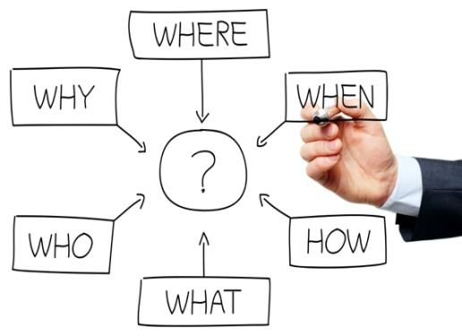

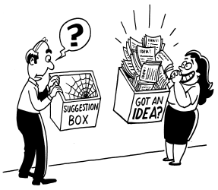
Any Questions/ Suggestions!!

